Slide 1
Ancient Egyptian religion, temples and festivals in Dynasty 18
Dr Eve Guerry
Macquarie University

Slide 2
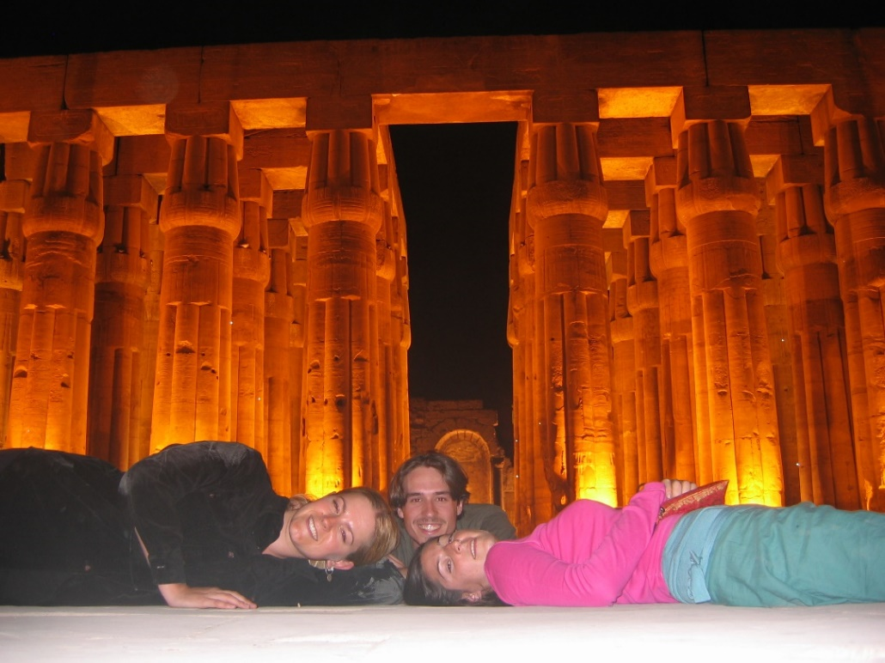
Ancient Egyptian religion, temples and festivals in Dynasty 18
Syllabus links
Ancient Egyptian Society in the New Kingdom
until the death of Amenhotep III
Religion
Temples
Festivals
Key questions
To what extent were the ordinary people involved in the religion and cult of New Kingdom Egypt?
What is the evidence for the role of religion in daily life during the 18th Dynasty and how and why does it change during this period?

Slide 3
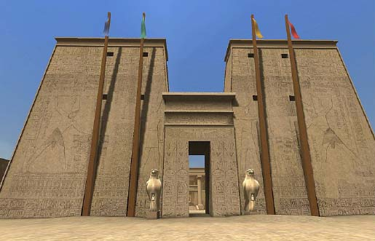

Official Temple Cult
http://dlib.etc.ucla.edu/projects/Karnak/experience
State religion, theoretically conducted by the king
Daily temple ritual conducted by priests on behalf of the king
Restricted access inside the temple
What involvement did ordinary people have in Dynasty 18 religion and cult?

Slide 4
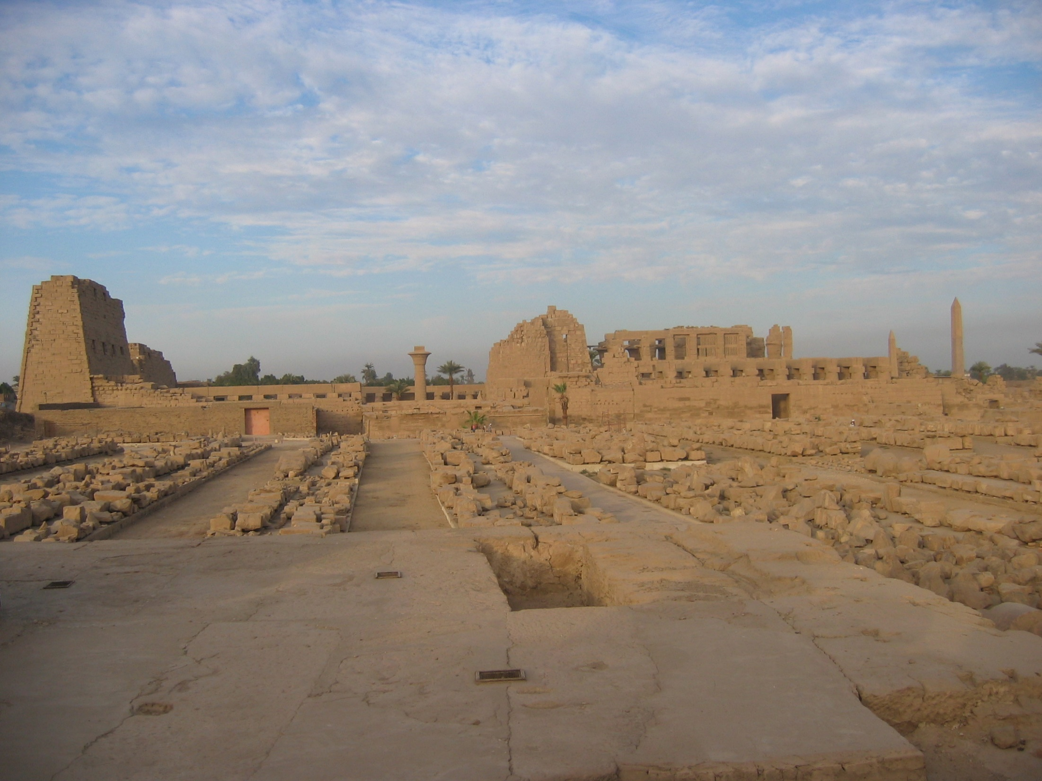
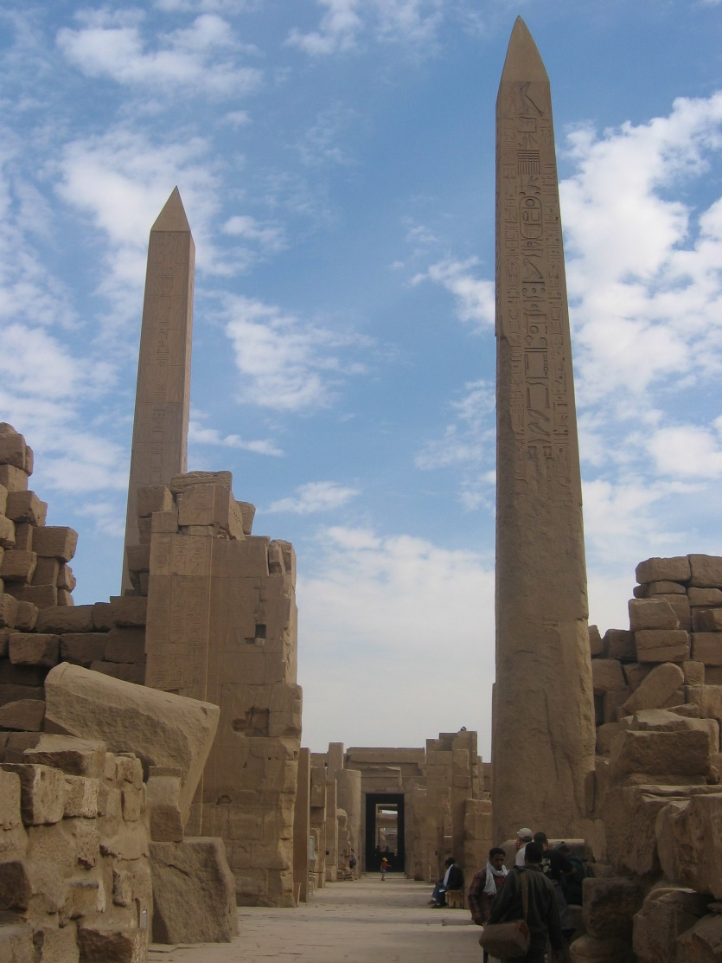
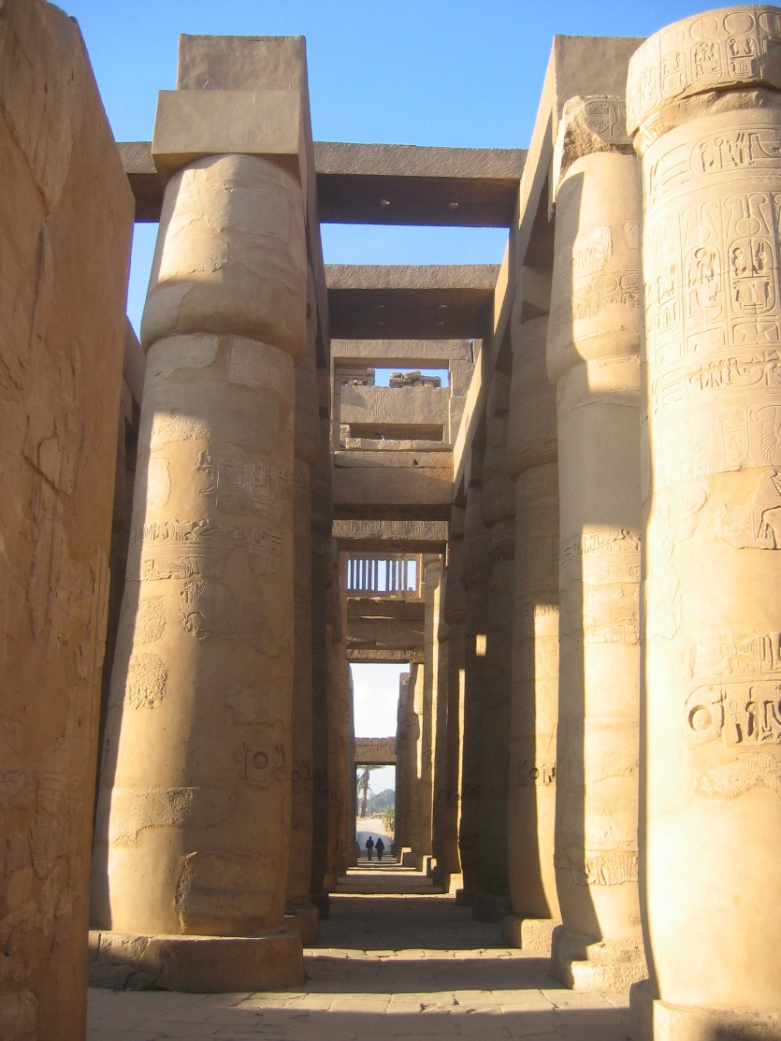
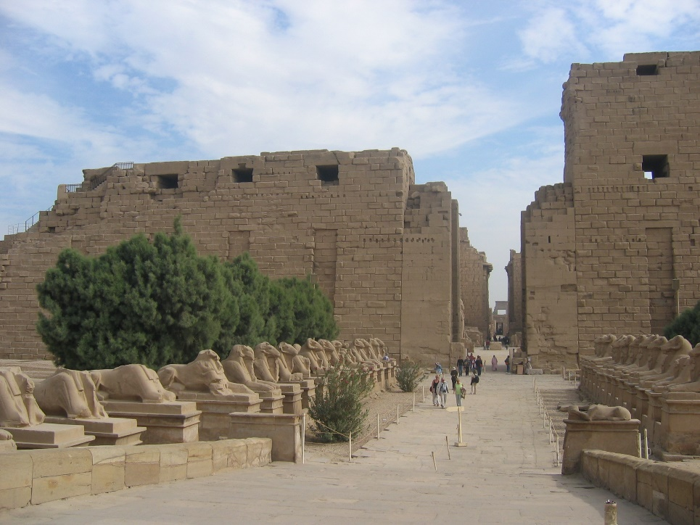
Great Temple of Amun at Karnak
Notes:
How do we get from the temple itself (image) to the plan? How do you read a plan?

Slide 5
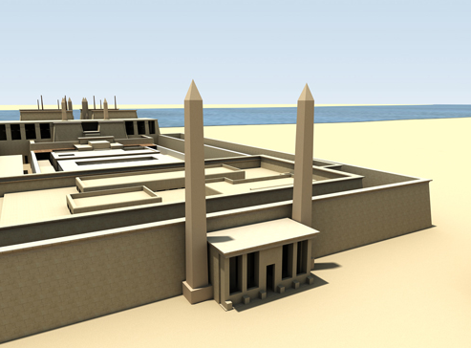
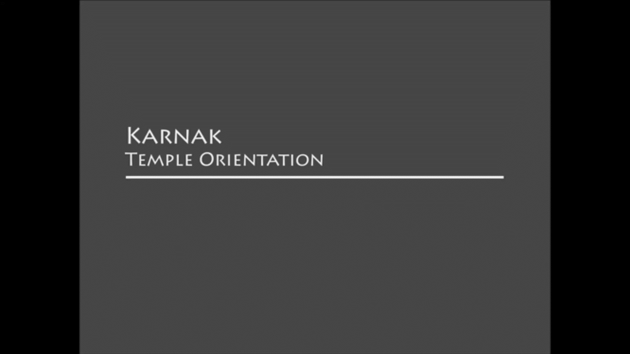
Digital Karnak University of California, Los Angeles (UCLA)
http://dlib.etc.ucla.edu/projects/Karnak/experience

Slide 6
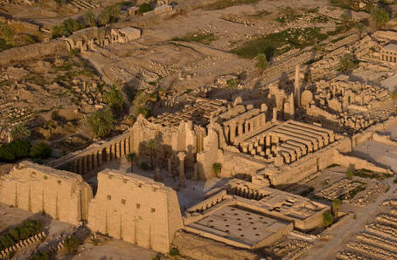
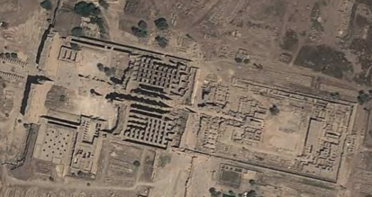
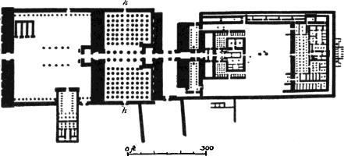
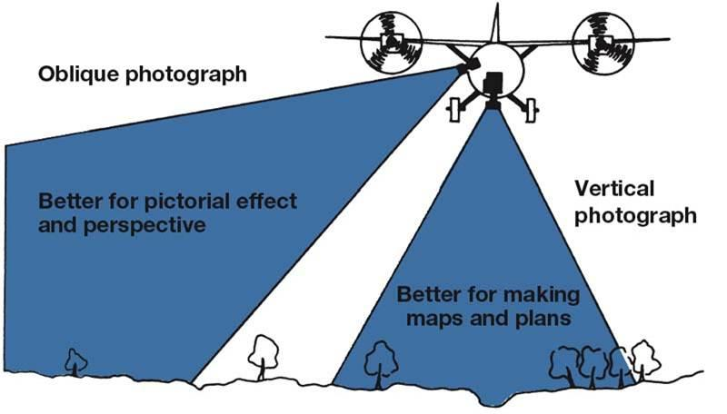
Great Temple of Amun at Karnak
Vertical aerial view
Oblique aerial view
S. R. Koehler, Architecture, Sculpture, and the Industrial Arts Among the Nations of Antiquity (Boston, 1879), pl.1, fig. 9.
Plan
Renfrew & Bahn (2012:79)

Slide 7
Temple entrance
Notes:
How do you know?

Slide 8
Courtyard
Notes:
How do you know it’s a courtyard?

Slide 9
Hypostle hall and Colonnaded hall
Notes:
Circles represent columns
Hypostyle = a building which has a roof supported by pillars, typically in several rows.

Slide 10
Sanctuary

Slide 11
Processional Way
Notes:
Barque chaels connected to processional way – link to concept of processions of the god.

Slide 12

Egyptian religion during Dynasty 18
Growing evidence of a direct relationship between gods and ordinary people.
Evidence:
Festival processions
Oracles
Votive offerings

Slide 13
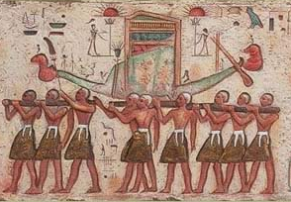
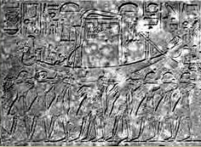
Opet festival
From the temple of Horus at Edfu (Greco-Roman Period)
From Hatshepsut’s chapel in Karnak (Dynasty 18)

Slide 14
Opet festival
Kingship rite, connecting the king with his divine father, Amun.
The power and legitimacy of kingship are ritually bequeathed by Amun to his son, the living Horus.
Belongs to official royal ideology and involved the personal appearance of the king.
First appears in Dynasty 18.
Centrality of the procession involved the people.

Slide 15
Processional Way
Notes:
Barque chaels connected to processional way – link to concept of processions of the god.

Slide 16
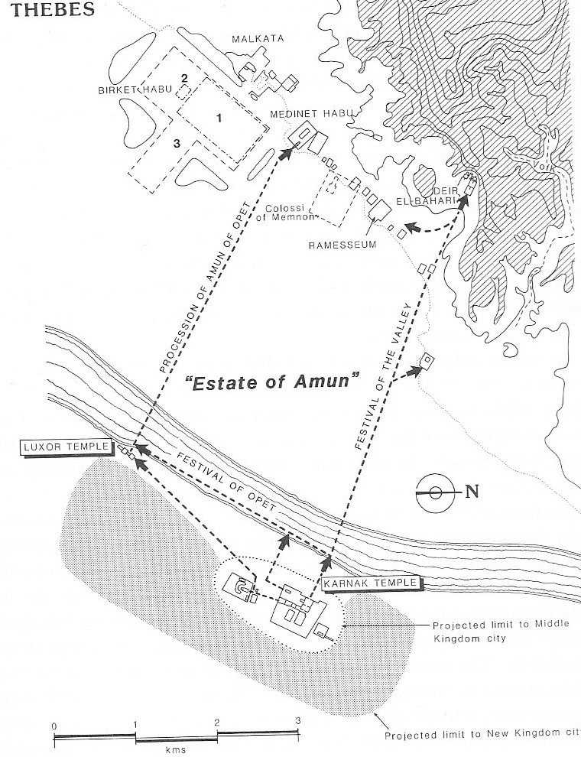
Processional Way
Public vs. private aspect of the temple cult
Public celebration during the festival procession
Begins in Dynasty 18
Opet Festival Procession
route
Kemp (1991: fig.71, p.203)
Notes:
Barque chaels connected to processional way – link to concept of processions of the god.

Slide 17
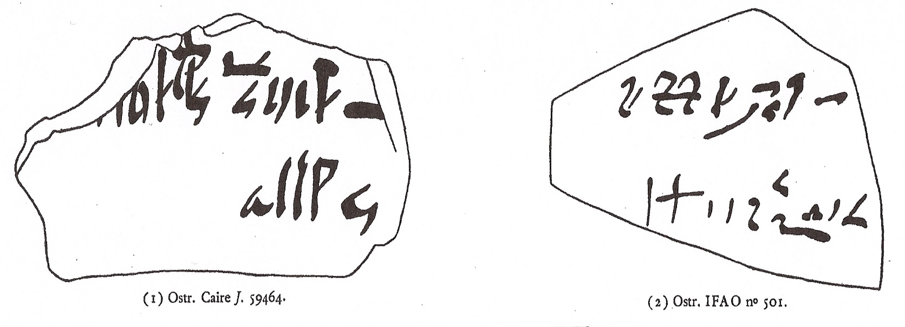
Oracles
Individuals could consult the god during festival processions
Evidence
Ostraca with oracle questions
“Was it he who stole the mat?”
“Will Seti be appointed as priest?”

Slide 18
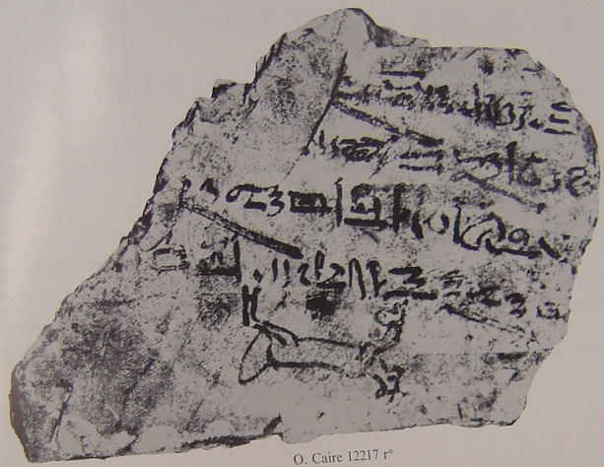
Votive Offerings
Individuals could have a direct relationship with the god
Evidence
Theban ostraca dedicated to Amun
Cairo ostracon 12217:
“Because your strength is greater than that of any god, I have placed you in my heart. With you as my protector I will not fear”.

Slide 19
Shrine of the “hearing ear” at Karnak temple

Slide 20
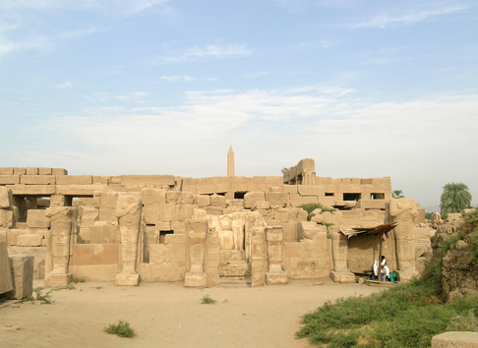
UCLA Reconstruction of the “Shrine of the hearing ear” of Thutmose III,
Temple of Amun at Karnak
“Shrine of the hearing ear” of Thutmose III,
Temple of Amun at Karnak
http://dlib.etc.ucla.edu/projects/Karnak/experience

Slide 21
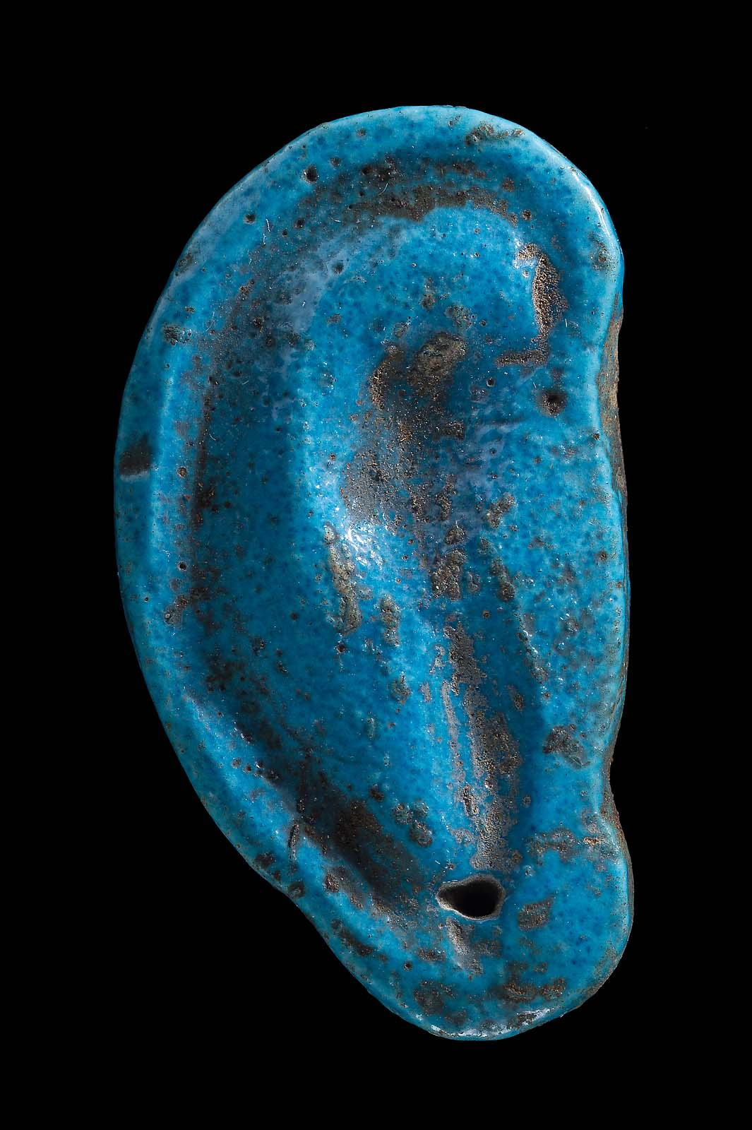
Amulet of a votive ear
Dynasty 18, Deir el-Bahari
Boston, Museum of Fine Arts, no.06.2466.
<http://www.mfa.org/collections/object/amulet-of-a-votive-ear-136179>

Slide 22
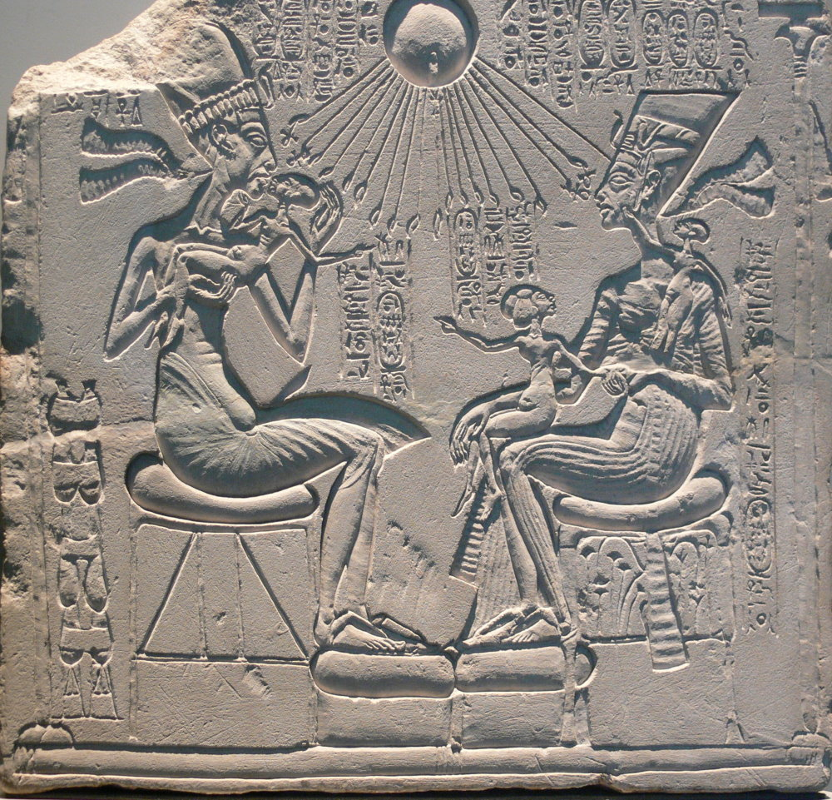
Amarna Period
King is the only connection to the god
Evidence
Hymn to Aten
“You are in my heart, there is no other who knows you, only your son, Akhenaten, whom you have taught your ways and your might.”
King is the focal point of personal devotion
Evidence
King replaces gods in
Household shrines
Tomb depictions
Festival processions
Household shrine from Amarna. Ägyptisches Museum Berlin, stele no. 14145

